Slide 2
https://www.youtube.com/watch?v=hVvAkSNM6VE

Slide 4
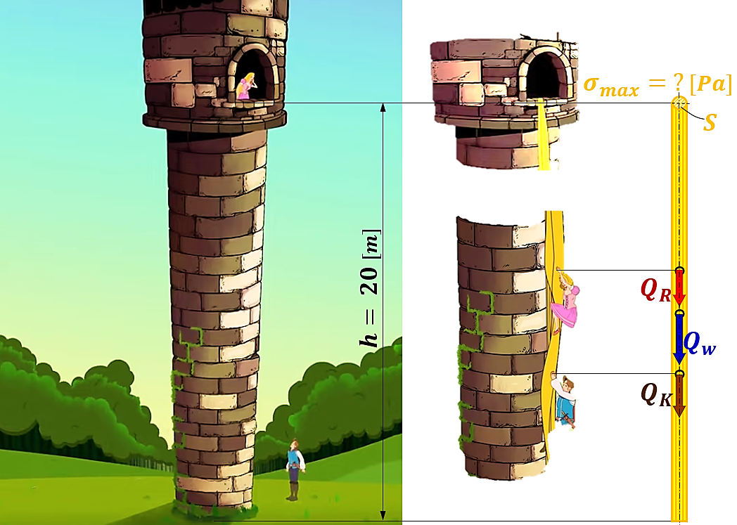

Slide 6
